Slide 1
API and Python training
Session 5

Slide 2
This session agenda
If-else, if – elif -else
While
For
Using control structures for handling API responses
Demo
Handling exceptions
Demo
---- Next session – part 2 ------
Python functions
Demo

Slide 3
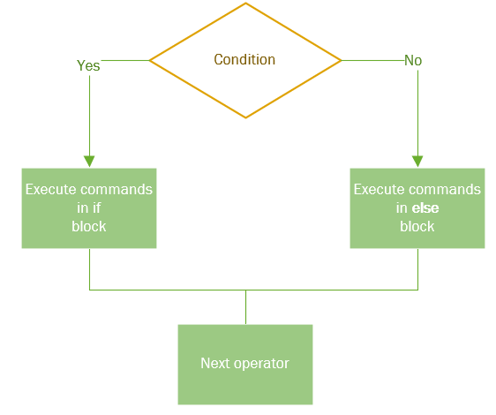
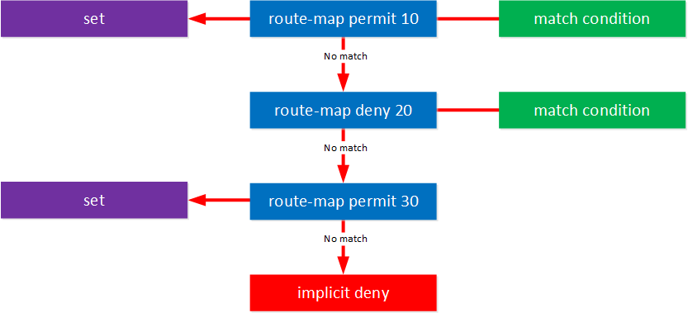
If … else or if … elif .. else
Note the colon at the end of the string
Else can be omitted, so may have a single if
if <condition>:
<block of code to run if the condition is True>
else:
<block of code to run otherwise>
If-elif if top condition matches, no further conditions will be processed
Similar logic to route-map or access-lists ------------------->
if <condition-1>:
<block of code to run if the condition-1 is True>
elif <condition-2>:
<block of code to run if the condition-2 is True>
else:
<block to run if no previous conditions matched>
https://networklessons.com/cisco/ccnp-route/introduction-to-route-maps

Slide 4

Conditions
Can be different, most common are comparison - always answers – True of False
Conditions depends on data type, examples:
Integers
if a == 10.8:
if response_code != 200:
if my_int_variable > 0:
Strings:
if my_string == test_string: exact match
if my_string in test_sting: substring match example: if ‘e’ in ‘hello’
Lists:
if <element> in <list> example: if 'red' in ['white', 'red', 'blue’]:
Can be multiple conditions:
if response_code == 200 and my_string == (test_string or another_string):
Not necessary to compare something with something, but use ‘shortcuts’
if my_string: - means if it’s not empty (string or list) or not 0 (integer)
if got_response: - the same as got_response == True:
You can use not:
if not a: - means a is not empty (string) or nor 0 (integer)
Image :http://queenelizabethsfantasy.blogspot.com/2014/11/to-be-or-not-to-be.html

Slide 5
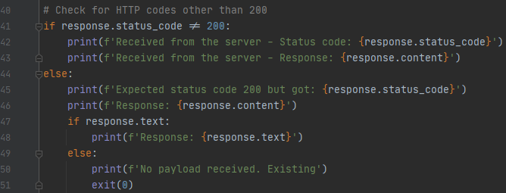
Indentation
Indicates where the block of code begins and ends. In C and Java-like languages you may see { }
You need to use the same number of spaces in the same block of code (Line 44, 45 and 47)
Any number of spaces as long as you follow previous rule, but recommended is 4
Don’t mix Tab and Spaces if you use a text editor or CLI, but IDE allows to do so and will convert Tab into spaces
https://www.geeksforgeeks.org/indentation-in-python/
https://www.w3schools.com/python/gloss_python_indentation.asp

Slide 6
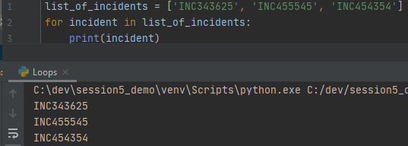
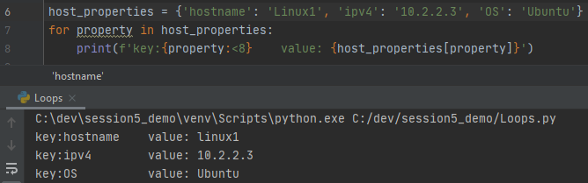
For loop
Syntax:
for <iterator-variable> in <list of another variables>:
<block of code>
For-loops in Lists
list_of_incidents = [‘INC34325’, ‘INC4545’, ’INC4543534’ ]
for incident in list_of_incidents:
print(incident)
For-loops in Dictionaries:
host_properties = {‘hostname’: ‘linux1’, ‘ipv4’:’10.2.2.3’, ‘OS’:’Ubuntu’}
for property in host_properties:
print(f’ Key:{property}, Value: {host_properties[property]}’)
Note you don’t have to define variable
<iterator-variable> in advance but you need to have
list or dictionary already defined
List comprehension – another powerful Python ‘shortcut’
Not necessary a list but any interable object, see
https://realpython.com/python-for-loop/
https://www.programiz.com/python-programming/list-comprehension

Slide 7
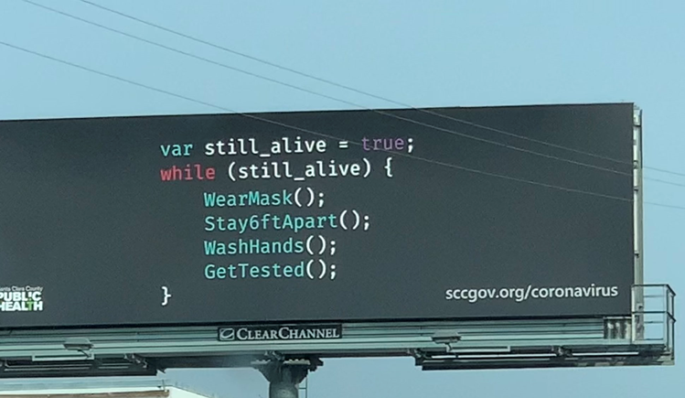
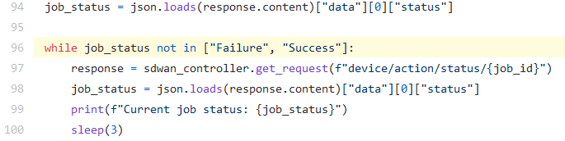
While loop
https://twitter.com/NBCian/status/1314352762319073280/photo/1
Syntax:
variable = <something>
while <condition is True>:
<block of code>
The <block of code> will run as many times and as long as <condition> remains True
Make sure <condition> can change within the loop to avoid indefinitely loop, or you can use break statement inside the loop
Condition – the same as in if-else
while a > 10:
while <string> in <List>:
while response:
Define the <variable> first to check in the condition
https://github.com/supro200/sdwan-auto-upgrade/blob/master/main.py

Slide 8
Using control structures while handling API responses
Typical use cases
Check status code
Check if response contains payload
Check if a key returned in the response (such as ‘result’)
Check if some keyword exist in the response
Iterate though the list returned from the server
While loops can used to poll server for a status

Slide 9
Demo

Slide 10
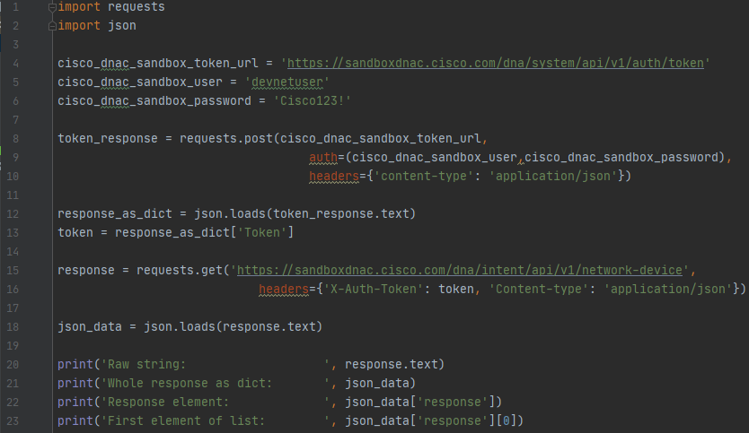
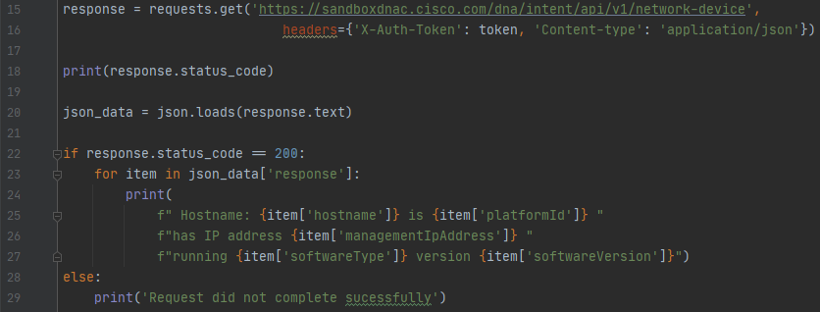
Demo 1 – adding checking response code and iterating through a list
<---- Code from Session 4
Changed code below
Added line 22 – checking response code
If response code is 200 – iterate through the list
Otherwise print error message

Slide 11
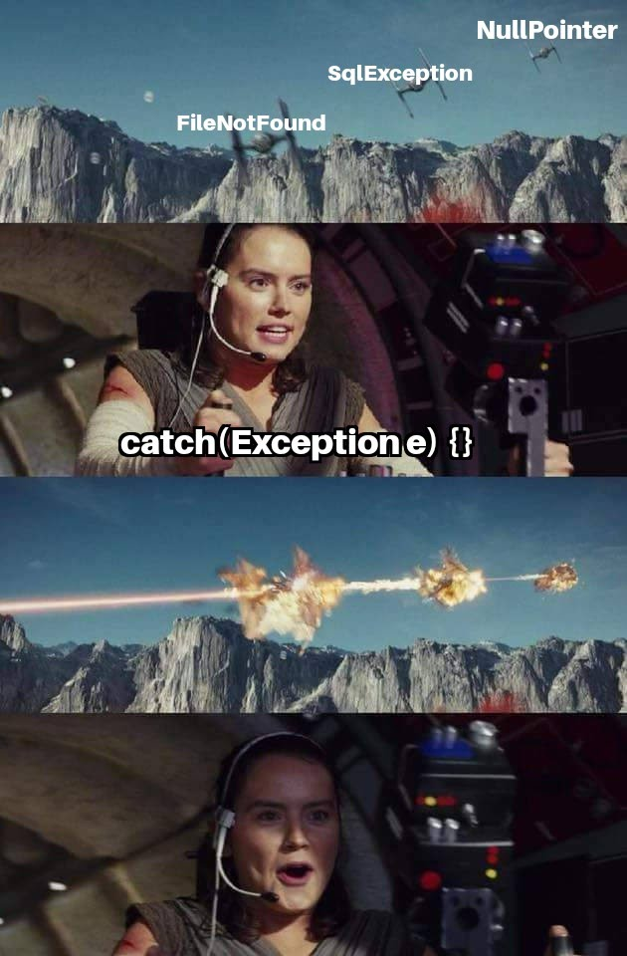
Exceptions
If there are errors during command execution there will be an exception
Python (and other languages) will give a detailed dump and terminates the module
If you anticipate there could be errors, put the fragment of the code in
try:
<dangerous fragment of the code>
except <error1>:
<how you handle this error>
except <error2>:
<how you handle this error>
else:
<no error – normal execution>
else is optional
You can handle different errors in different except statements
Try to avoid putting too much code into try-block and or catching all errors, unless you provide your users with a message ‘Something went wrong’
This is a joke ---------->
Good reference: https://stackoverflow.com/questions/16511337/correct-way-to-try-except-using-python-requests-module
Example on handling ssh errors: https://github.com/supro200/fw-rule-helper/blob/master/fwhelper/common/network_helpers.py#L55

Slide 12
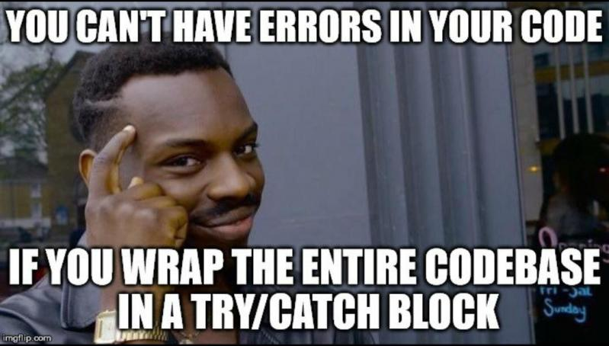
Demo
Notes:
Let me show an example on how to handle Exceptions

Slide 13
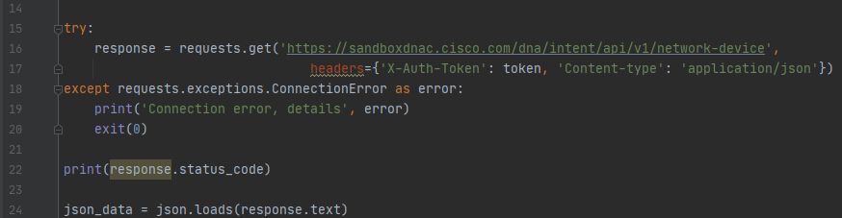
Demo 2 – adding exception handling – exit
<---- Code from previous demo
Changed code below
Original line 15 is in try – except block
If connection times out – exit the program

Slide 14
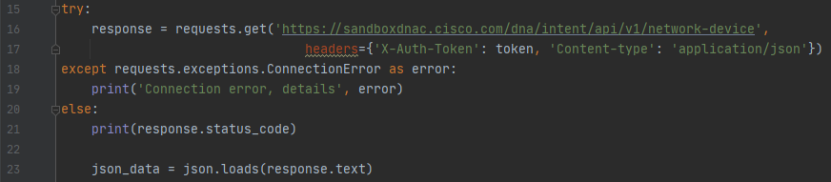
Demo 3 – adding exception handling – try-except-else
<---- Code from previous demo
Changed code below
Instead of exit, print error
Added else statement – run block of code if there were no exceptions

Slide 15
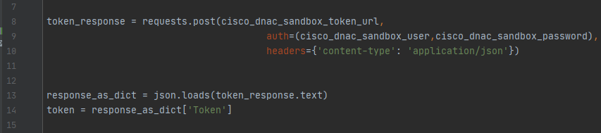
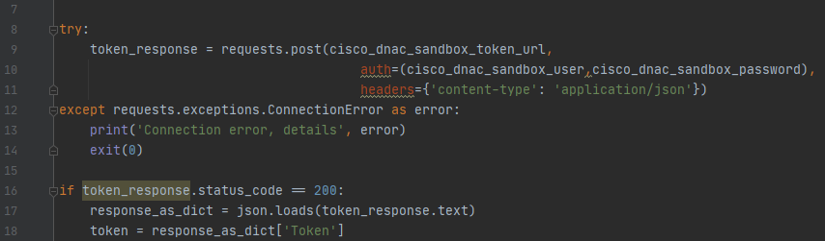
Demo 4 – getting token - add exception handling and status code checking
<---- Original code
Changed code below
Line 8 – put getting token into try-except statement
Line 16 – checking return code

Slide 16
Summary and next steps
Summary
Python – control structures – if, for, while
Handling exceptions
Next time this session will continue
Python functions

